Slide 1



Major Project - COM-811
Pingfence
SOTA Intrusion Detection Framework
Aadhaar Koul(Team Leader)
Project Incharge -
2020a1r040

Slide 2
Contents
Problem Description
Global Landscape
Previous Contributions
Proposed Solution
Tech Stack
Framework
Workflow
Project/ Modules
Demonstration

Slide 3
Problem Description
Cyber-crime now a days is booming at an alarming rate. The naiveness and the lack of awareness among the users has increased the rate of cyber-crime by a large number. The most common attacks to which the users are most susceptible are the phishing and the MITM(Man In The Middle Attacks) that are usually carried out on the free public WIFI's and home gateways. An estimate of about 10.5 Trillion Dollars is the round figure that cyber frauds are going to cost the world in the coming years.
Problem 1
People don't really care about their online activities and the cyber-crimes until they encounter one.
Problem 2
Intrusion is not only limited to internet world but also is being observed in physical world, i.e., in lodgings.
Problem 3
There are different types of cyber-attacks and physical intrusions but no one stop solution currently available.

Slide 4
Solution 1
Development of an advanced intrusion detection framework, automation, and notification system using the state of the art technology.
Solution 2
Creating a hardware and software solution that accurately classifies the level of intrusion in a premises or Local Area Network/Wide Area Network.
Solution
One stop Intrusion Detection System
Solution 3
Design and implementing an IoT-Protocol-based locking system that prevents unauthorized access to the property using Deep Neural Networks .
Solution 4
Making the solution available to a common man by using low cost , efficient hardware that provides the same set of functionalities that of a large scale IDS.

Slide 5


















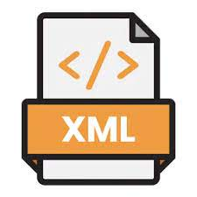
TECH STACK
Framework
Ai / ML / CV
Frontend / Interface
Backend
Cloud
IOT
Hosting
Operating System

Slide 6
FRAMEWORK
IP surveillance camera
Ultrasonics
Laser sensors
Network Sniffer
Honeypot Systems
Motion Sensors
PIR Sensors
VPN
Detection Sensors
Home Security system
Smart Notification System
Wi-Fi
Door Lock
Network and home automation Control platform
Admin control application
Arduino
Home Gateway
Media Server
Appliances
Appliances
WWW
TV
Storage

Slide 7
WORKFLOW
User turns on the IDS
Keep True
Honeypots , Notification systems , Detection sensors , Network Sniffers , and the web app portals are configured and turned on.
NO
Intrusion
Detected
NO
NO
YES
Tables and databases
Updated
Admin blocks
the intruder / Enables security protocols
Admin takes necessary actions
YES
YES
Intruder information saved via honeypots
Smart Notification
System sends alerts and advisory messages to the admin
All Systems lockdown,
Intruder Blocked from
entering the system

Slide 8
PRODUCT MODULES
Network Gateway Module
Honeypot Module
IOT Modules
Blynk Cloud Module
Computer Vision Module
Surveillance Module
Android App Module

Slide 9
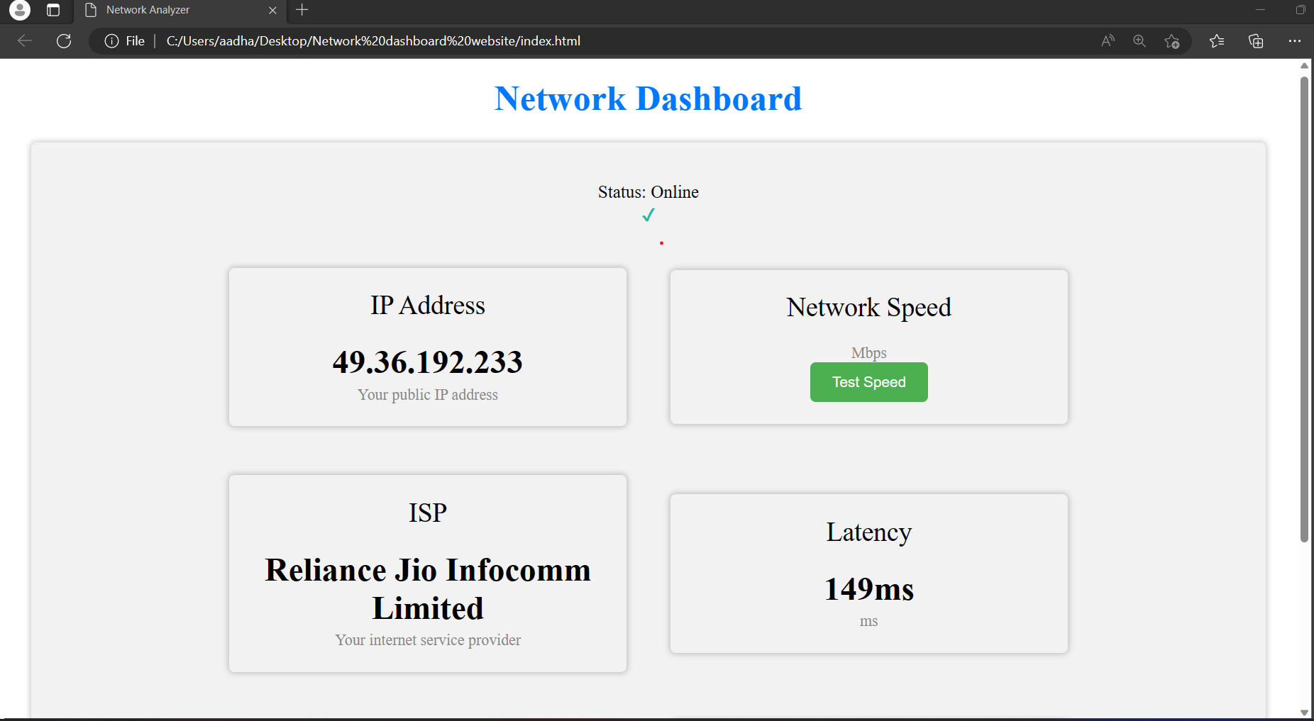

NETWORK GATEWAY DASHBOARD
Features
* Login functionality
* Network IP
* Network Speed
* ISP
* Network Latency
* Router’s IP
* DNS IP
* Apache2 Network Load Balancing
Test it Out on your device:

Slide 10
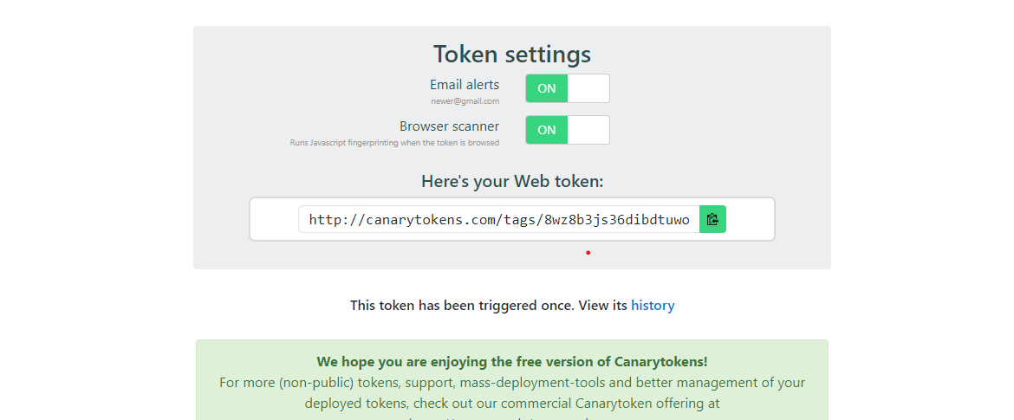
HONEYPOT SYSTEM

Slide 11
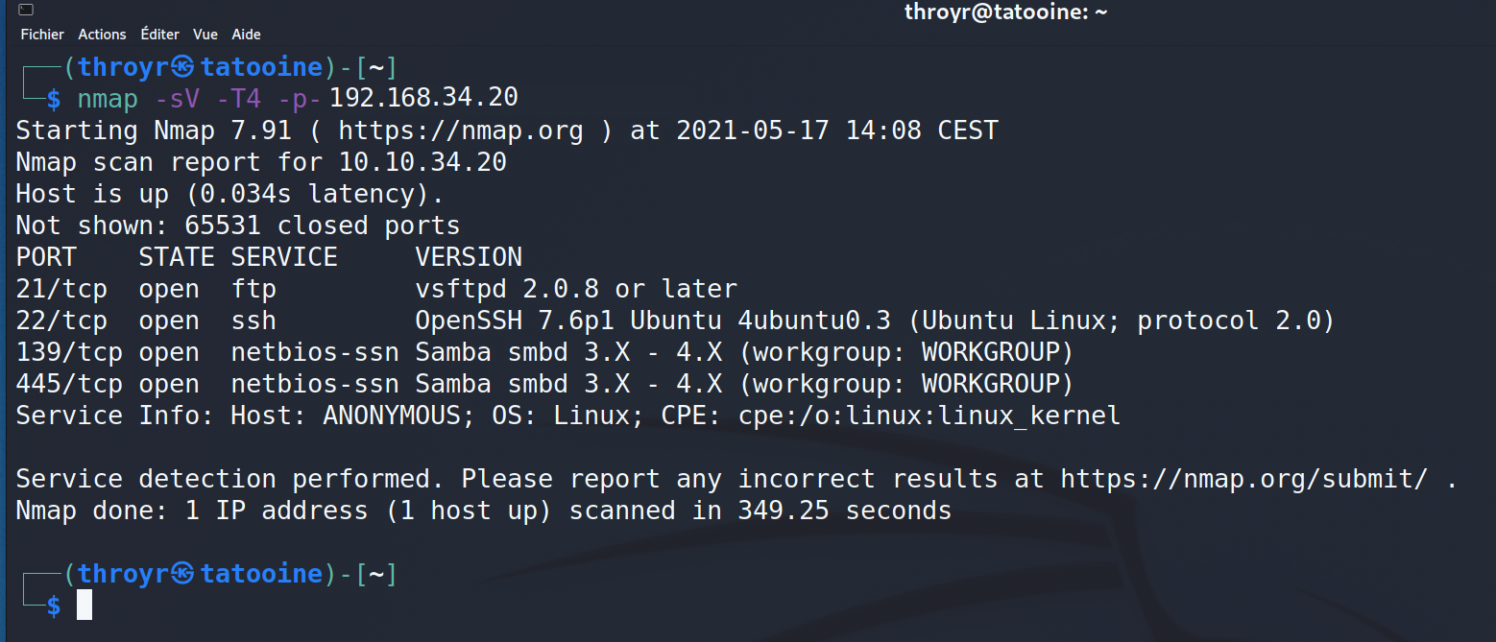
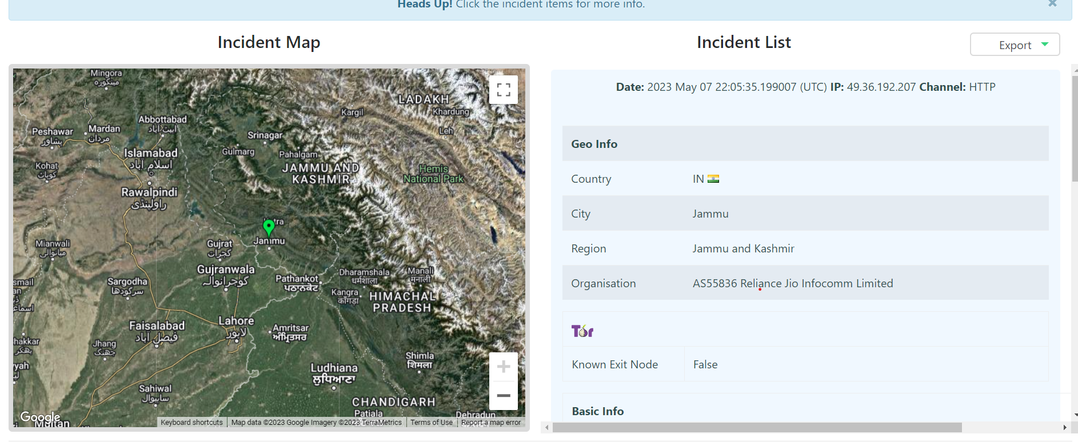

Features
* Decoy Vulnerable FTP server
* Flag based Tracking
* Type of attack vector identification
* Attack vector Location
* Attacker IP address
* Realtime network monitoring
Test it Out on your device:

Slide 12
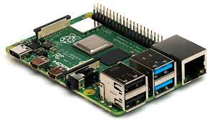
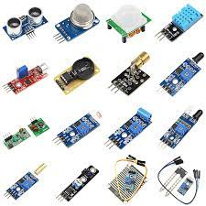
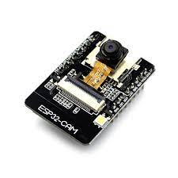
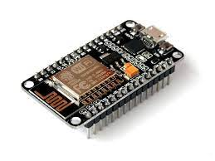
HARDWARE COMPONENTS
Micro Computers
Raspberry Pi 4 Model B
Sensors
Wi-Fi Module
ESP 8266
Camera Module
ESP 32 CAM

Slide 13
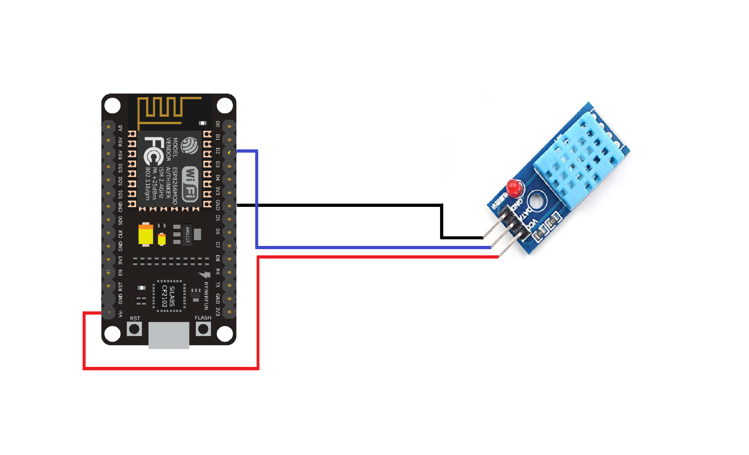
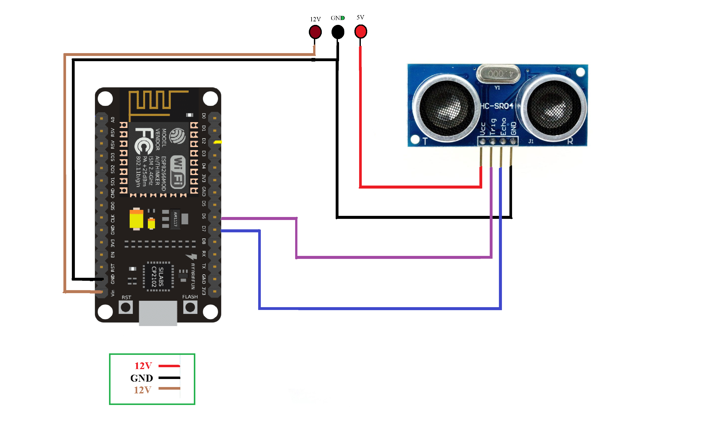
IOT DEVICES
TEMPERATURE AND HUMIDITY SENSOR
ULTRASONIC SENSOR

Slide 14
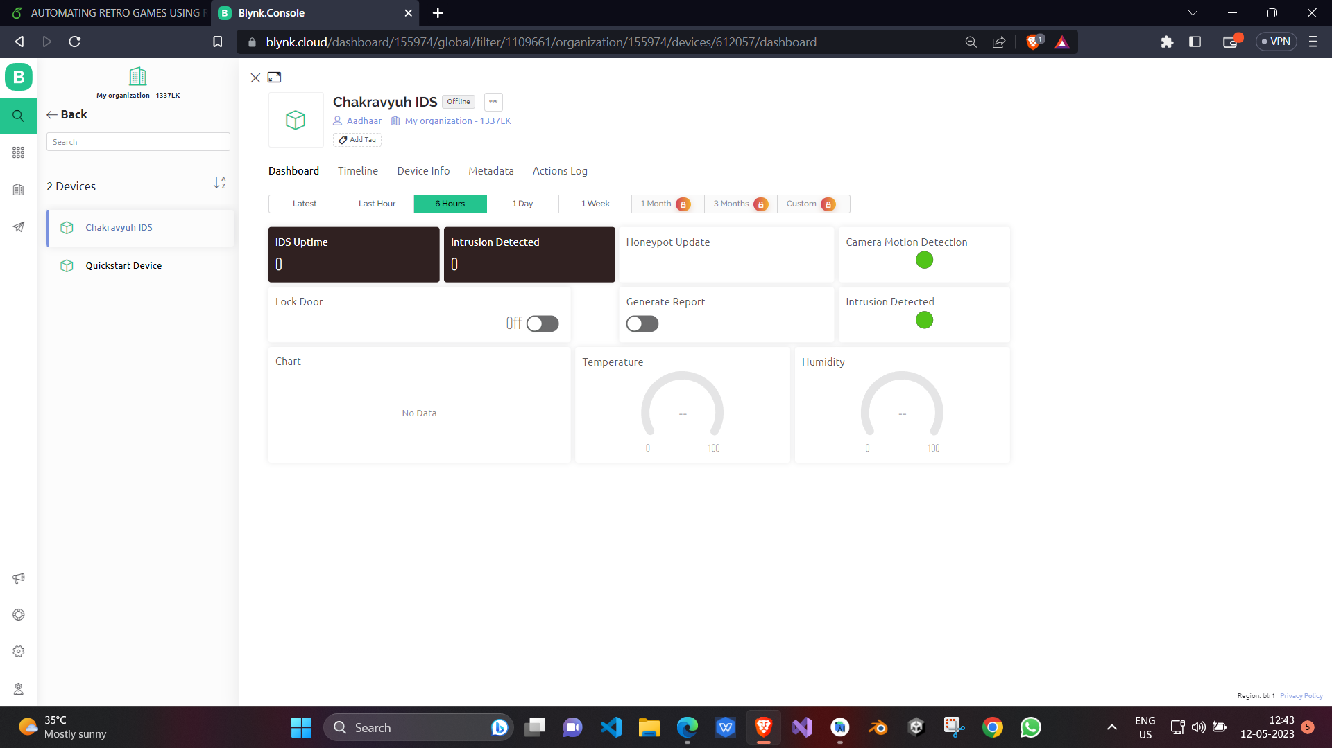
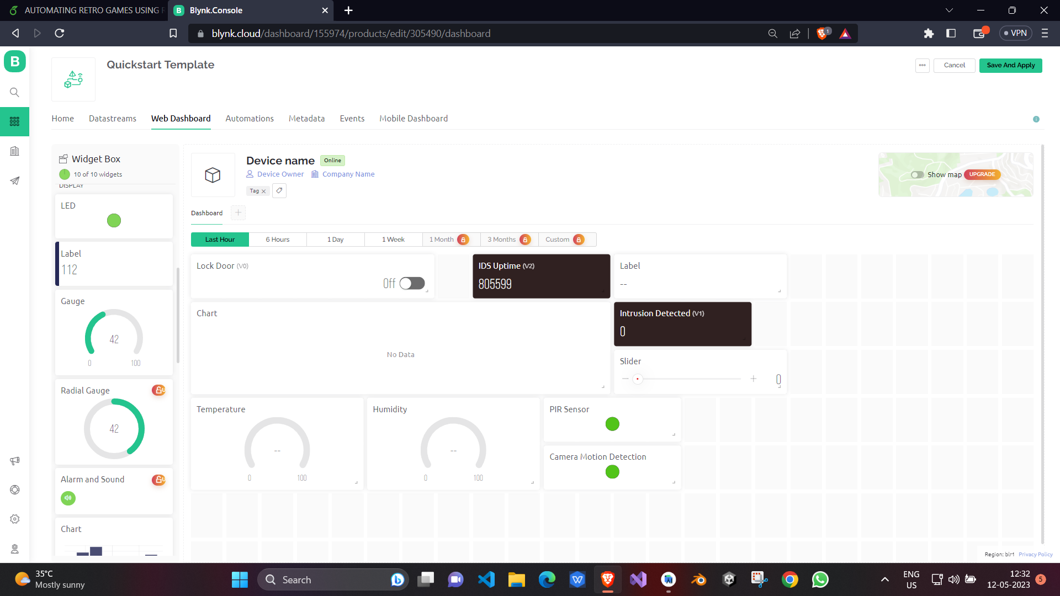
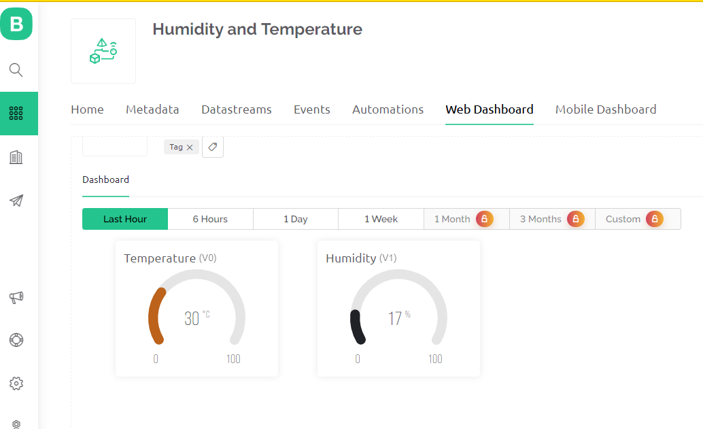
BLYNK CLOUD DASHBOARD
Features
* Real time sensor readings
* Seamless UI
* Integratable API Key
* Mobile and Web based platforms available.
* Drag and Drop Modular / admin dashboard
* Receive real time push and email notifications.
* Modular

Slide 15
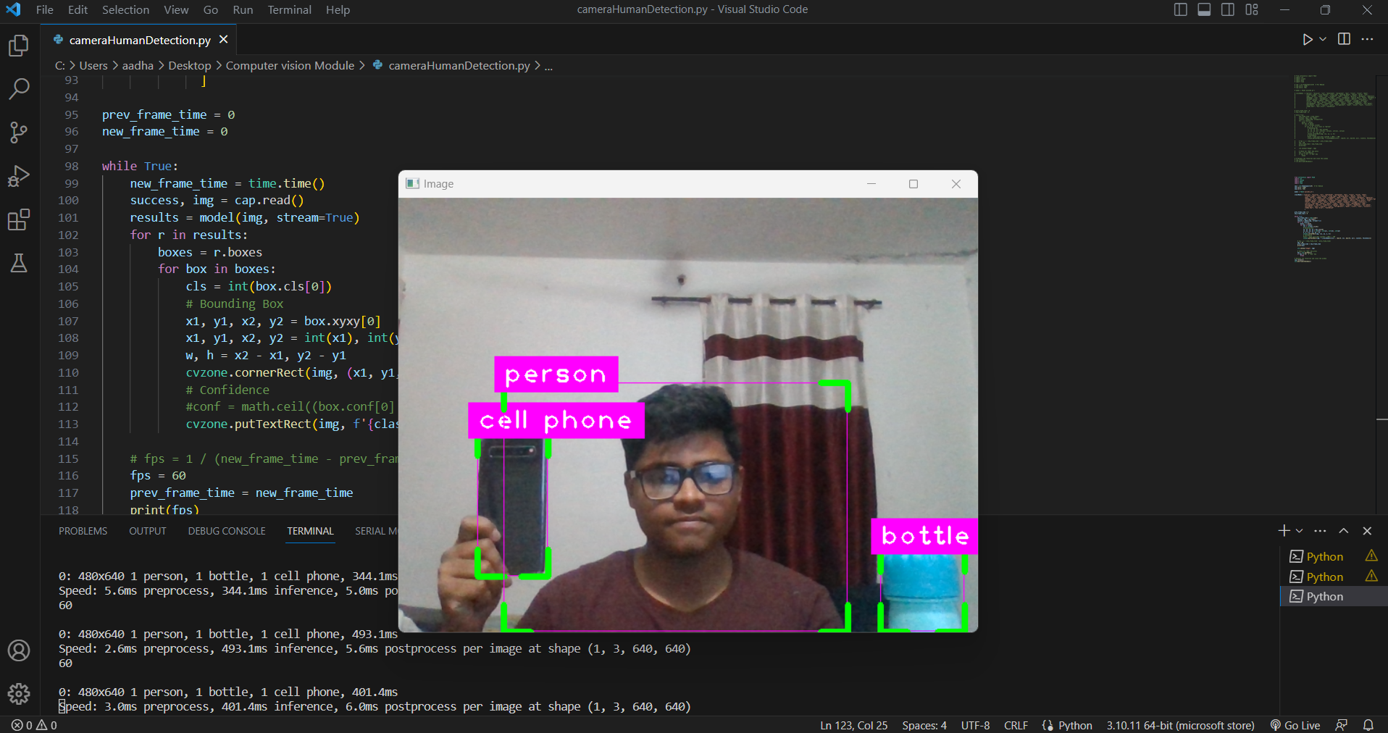
COMPUTER VISION MODULE
Features
* Login functionality
* Network IP
* Network Speed
* ISP
* Network Latency
* Router’s IP
* DNS IP
* Apache2 Network Load Balancing
Test it Out on your device:

Slide 16
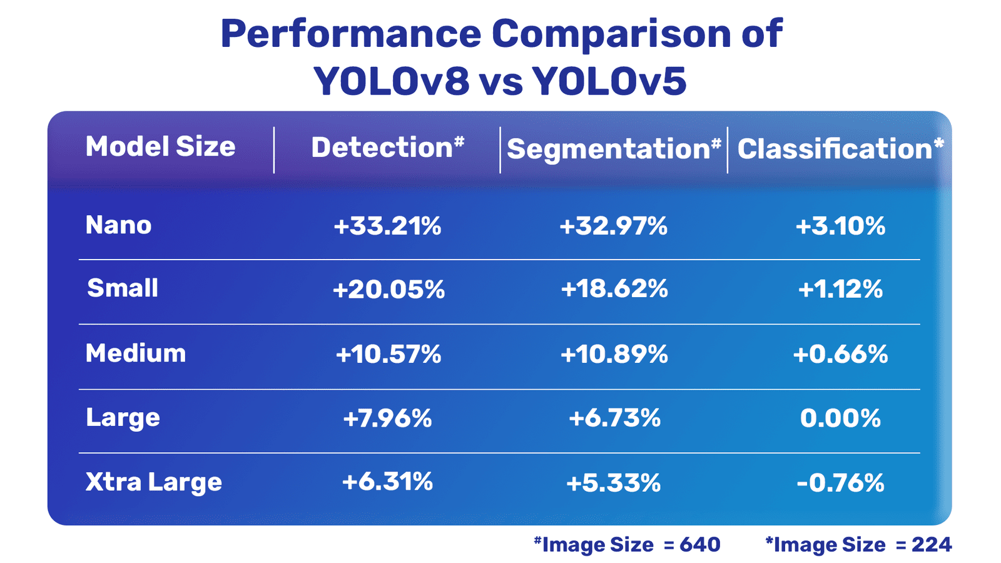
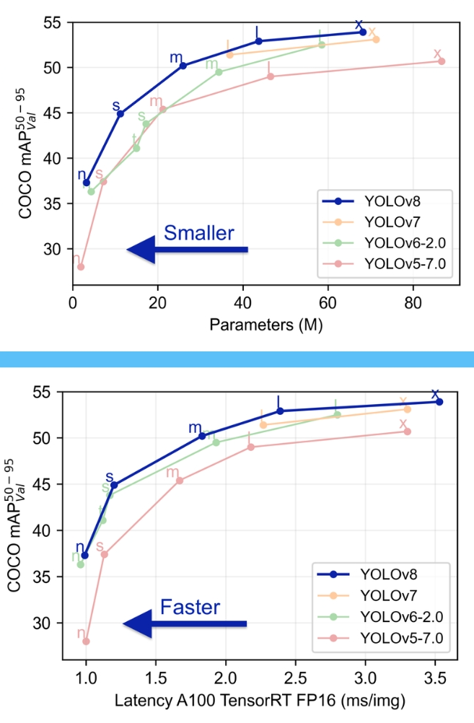
Traction

Slide 17
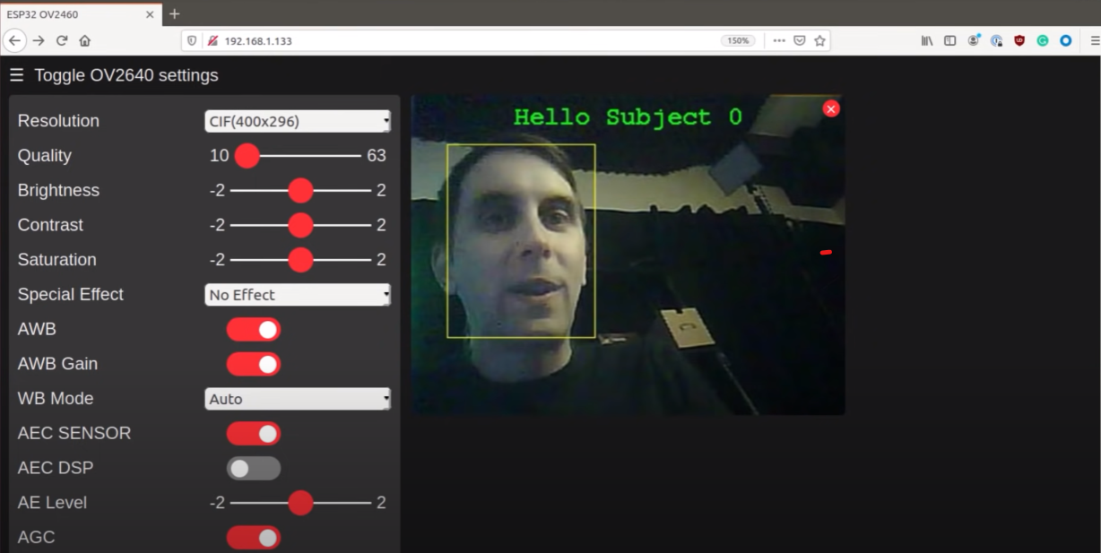
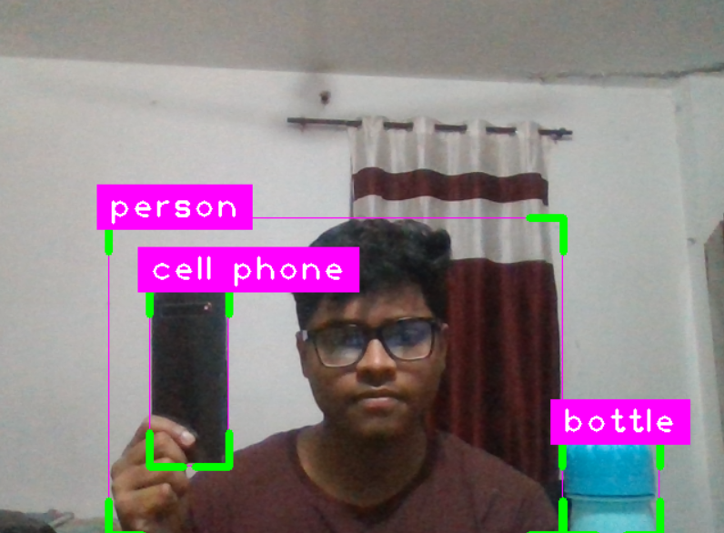
SURVEILLANCE DASHBOARD
Features
* Login functionality
* Network IP
* Network Speed
* ISP
* Network Latency
* Router’s IP
* DNS IP
* Apache2 Network Load Balancing
Test it Out on your device:

Slide 18
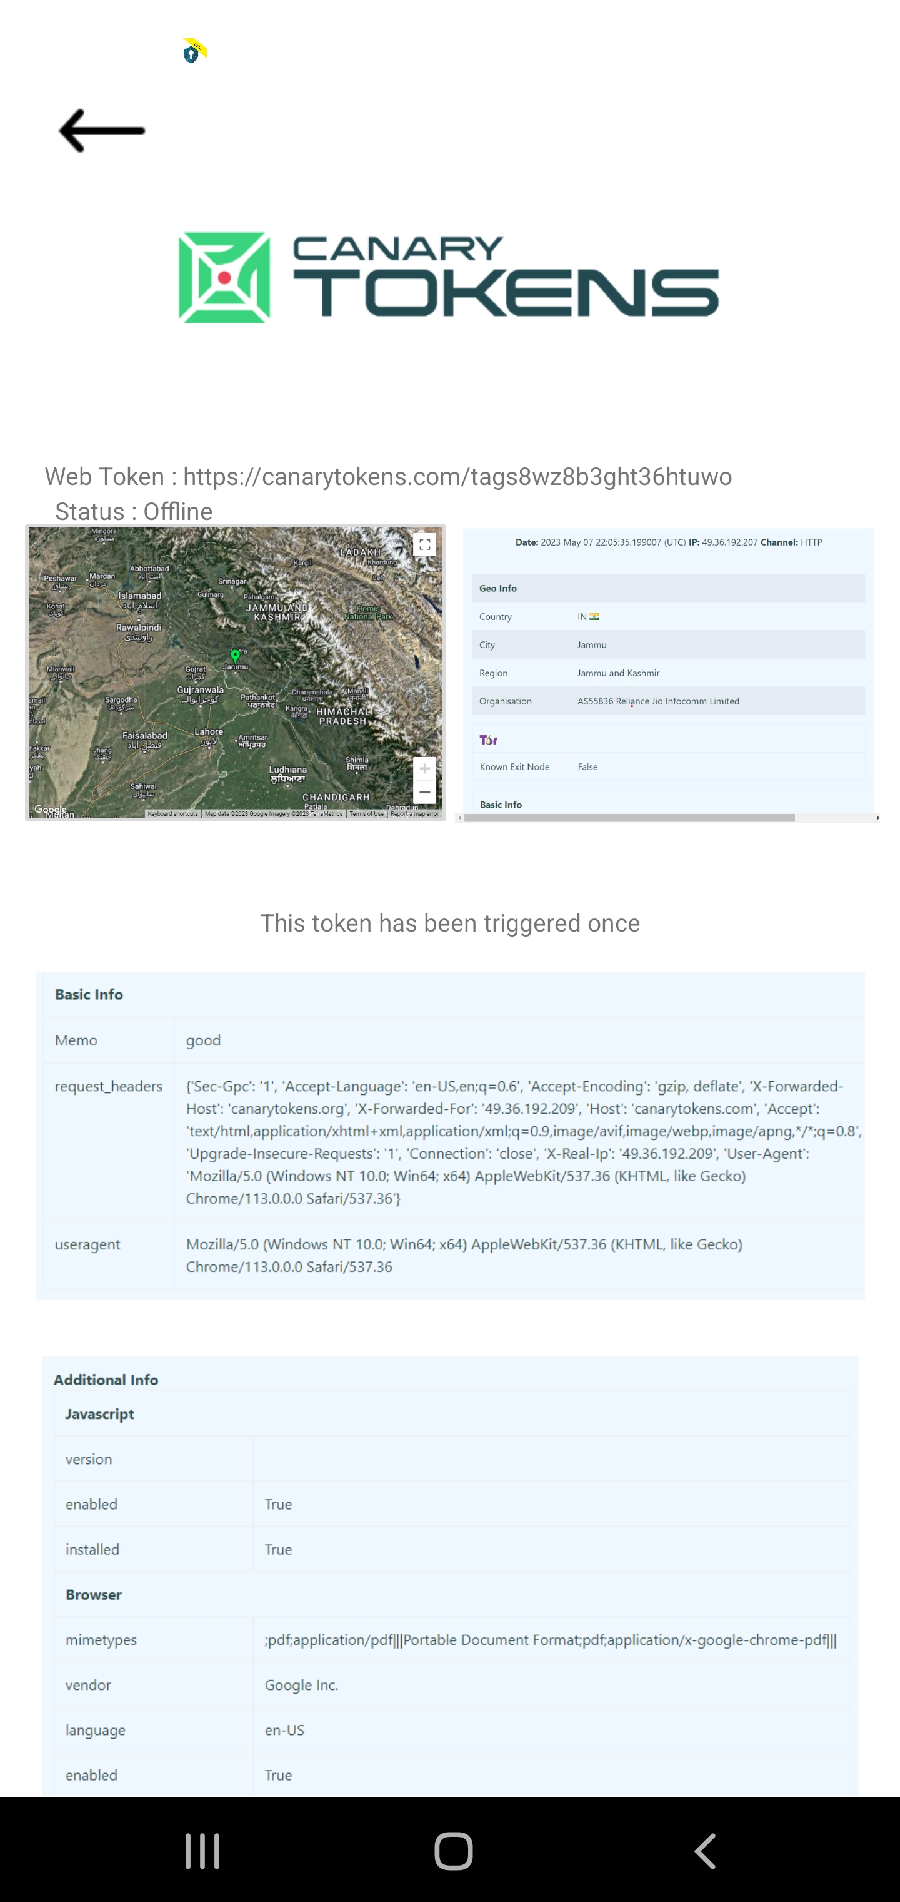
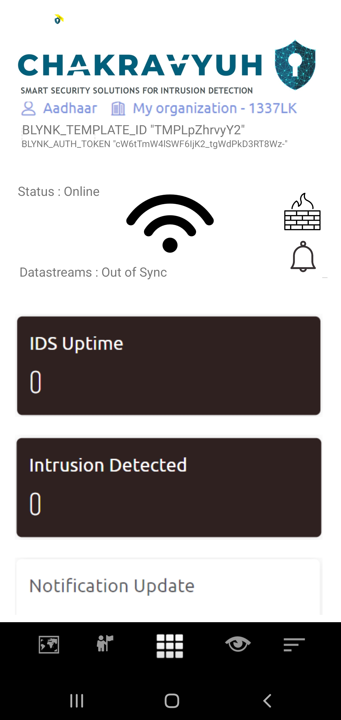
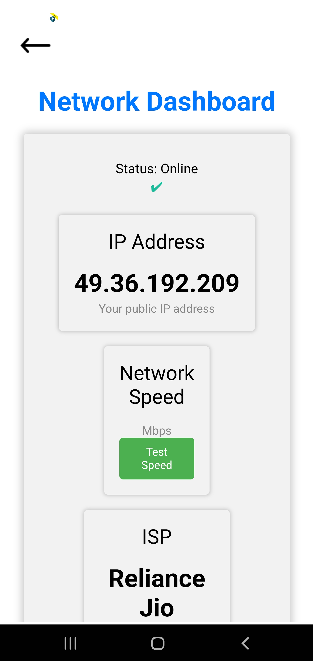

ADMIN CONTROL APPLICATION
Features
* Real time Sensor Readings
* Push Notification
* Seamless Interface
* Admin Login Functionality
* Supported version of Android6.0 and Above
* Analytical report Dashboard
* Remote access functionality
* AR control Functionality
Test it Out on your device:

Slide 19
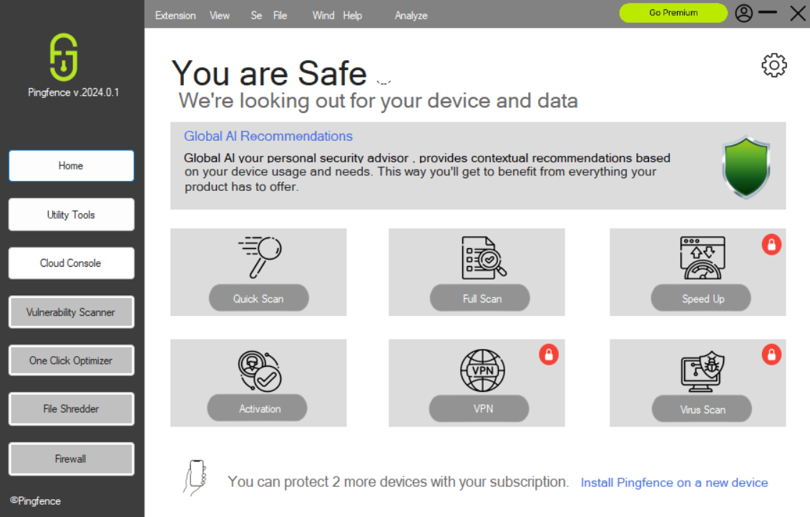
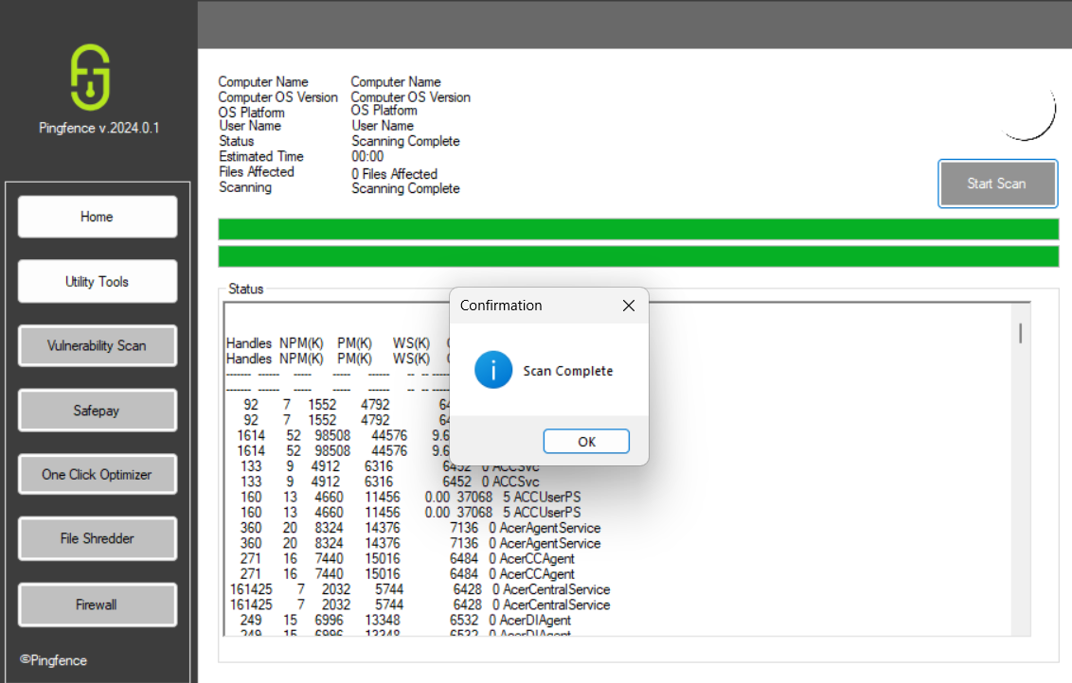
ONE STOP SOLUTION
Features
* Malware Protection
* IOT API Integration
* Seamless Interface
* Admin Login Functionality
* Network Sniffer Functionality
* Analytical report Dashboard
* Remote access functionality
* VPN Functionality

Slide 20
Target Market
General Public
Government Agencies
Companies / Enterprises
Large Scale Industries
Small scale Industries

Slide 21
Direct Competitors
Indirect Competitors
Bitdefender
IBM Qradar
Cisco IDS/ IPS
Rapid 7
McAfee Host IPS
Cylance PROTECT
Cisco IDS/ IPS
Splunk
Snort

Slide 22
DEMONSTRATION

Slide 23
Step 1
Increased Use of AI and Machine Learning
Future Roadmap
Step 2
Integration with Cloud- Based Security
Step 3
Expansion of IoT Security
Step 4
Cross Platform Support

Slide 24
QUESTIONS ?

Slide 25
THANK YOU

